Slide 1

VALLURUPALLI NAGESWARA RAO VIGNANA JYOTHI INSTITUTE OF ENGINEERING AND TECHNOLOGY
Department of Computer Science and Engineering
Neural networks

Slide 2
The idea of ANNs..?
NNs learn relationship between cause and effect or organize large volumes of data into orderly and informative patterns.
It’s a frog
frog
lion
bird
What is that?

Slide 3
Neural networks to the rescue…
Neural network: information processing paradigm inspired by biological nervous systems, such as our brain
Structure: large number of highly interconnected processing elements (neurons) working together
Like people, they learn from experience (by example)

Slide 4
Definition of ANN
“Data processing system consisting of a large number of simple, highly interconnected processing elements (artificial neurons) in an architecture inspired by the structure of the cerebral cortex of the brain”

Slide 5

Artificial neural networks
Artificial neural networks, usually simply called neural networks or neural nets, are computing systems inspired by the biological neural networks that constitute animal brains. An ANN is based on a collection of connected units or nodes called artificial neurons, which loosely model the neurons in a biological brain.

Slide 6
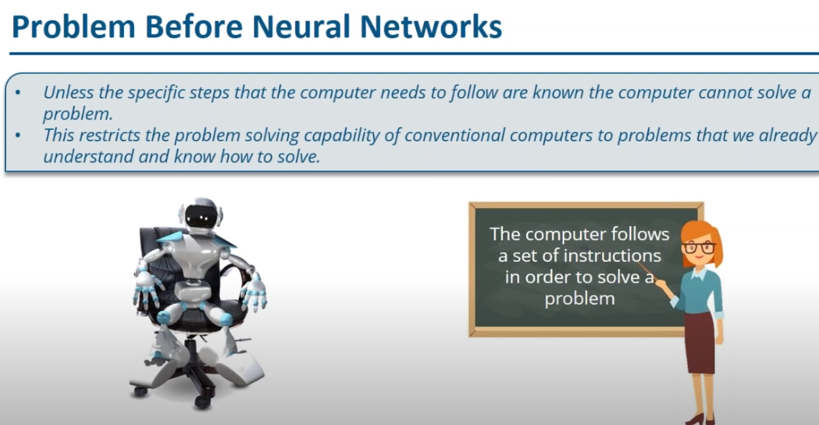

Slide 7
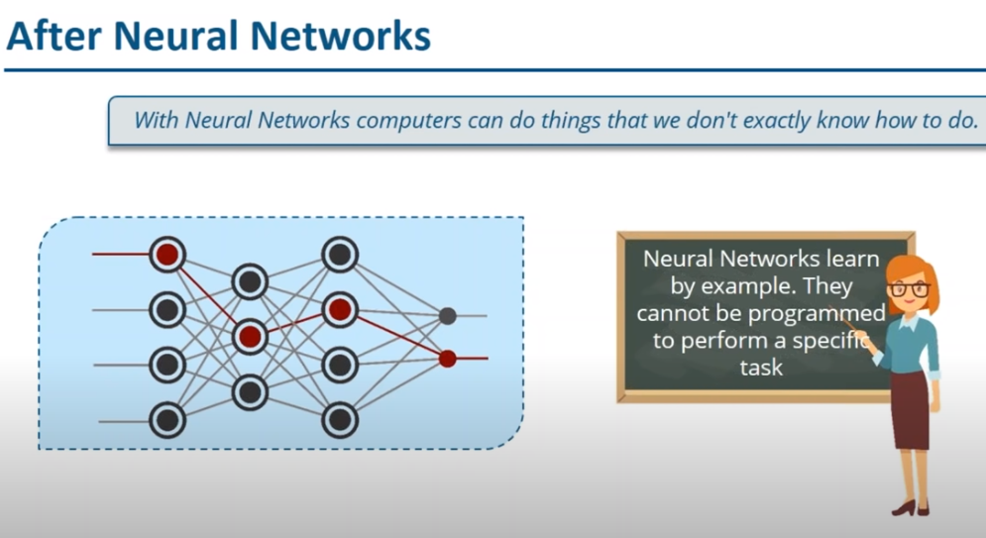

Slide 8
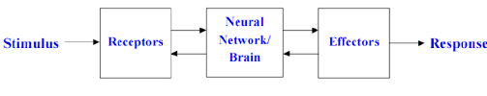
Block diagram for neural network

Slide 9
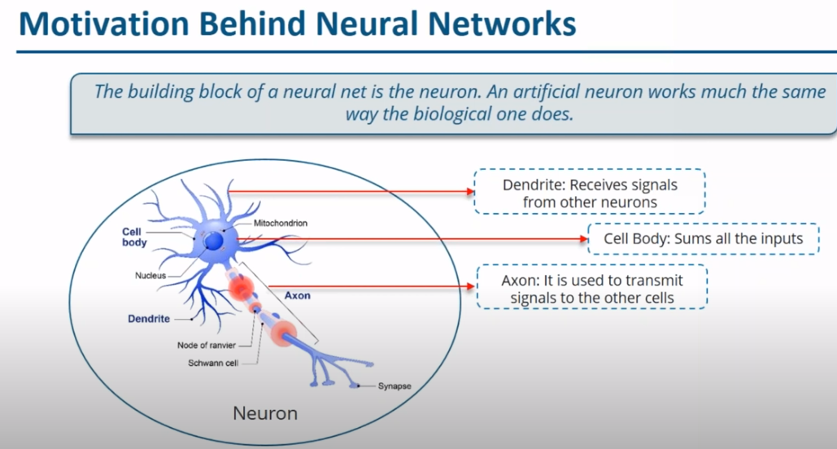

Slide 10
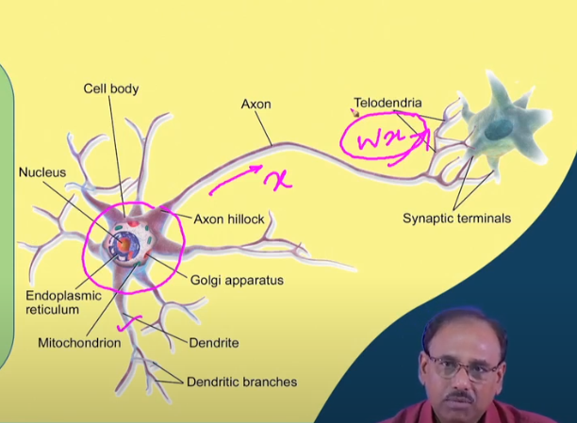
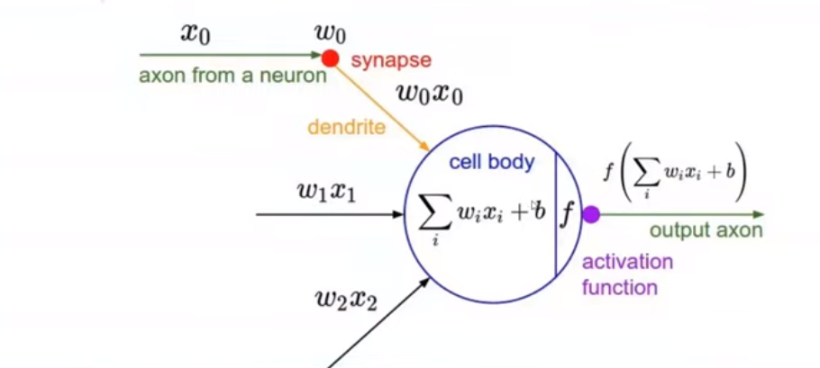
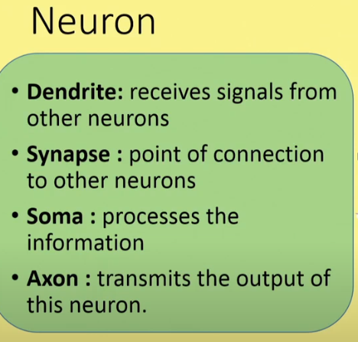
Biological neuron
Artificial Neuron
Notes:
Axon finally branches out and connects to other neurons through synaptic connections. During this process there is a multiplicative interaction

Slide 11
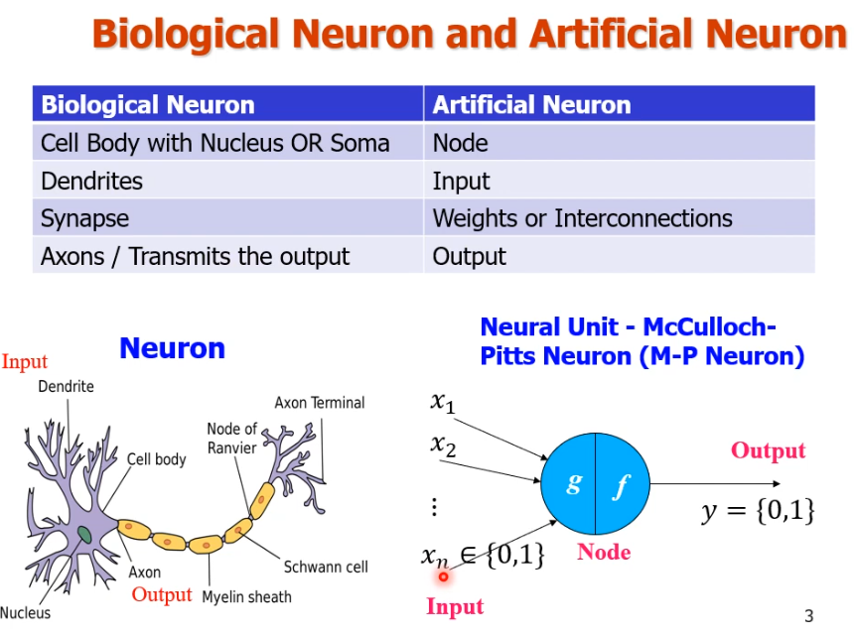

Slide 12
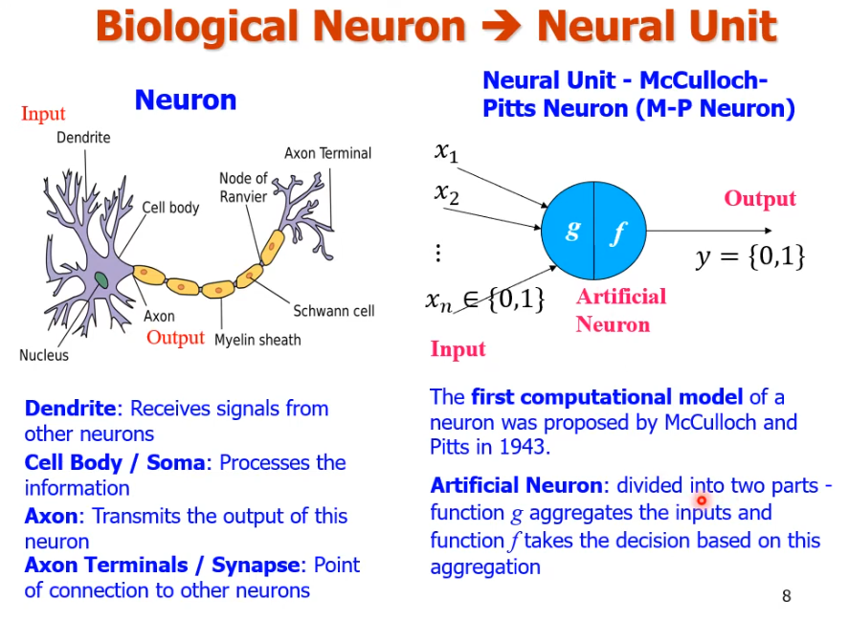

Slide 13
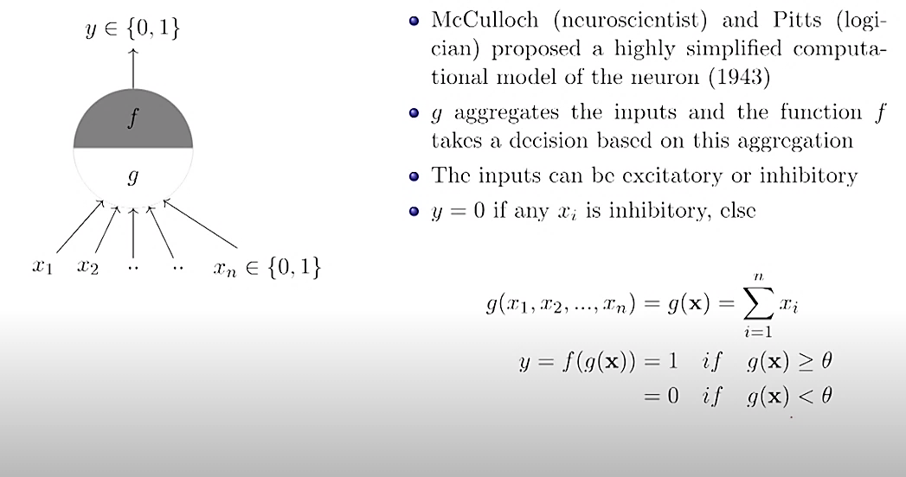
McCulloch Pitts Neuron, Thresholding Logic

Slide 14
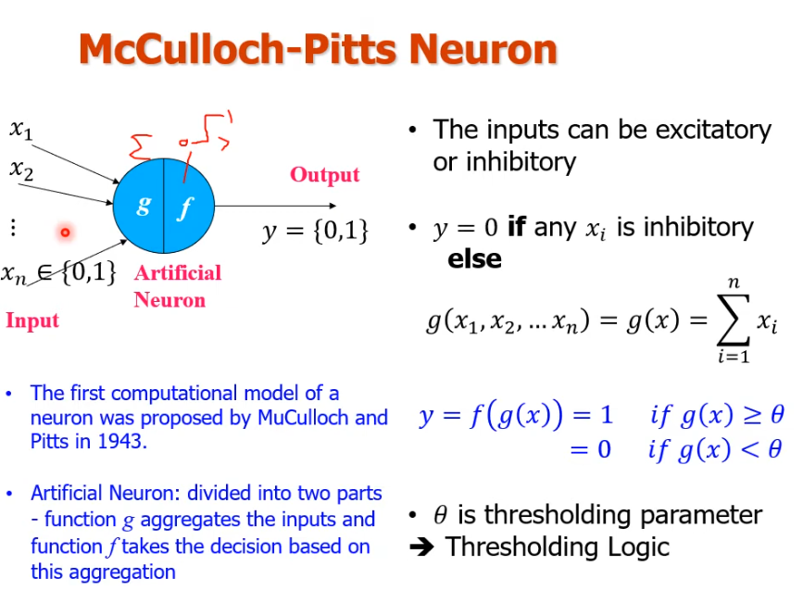

Slide 15
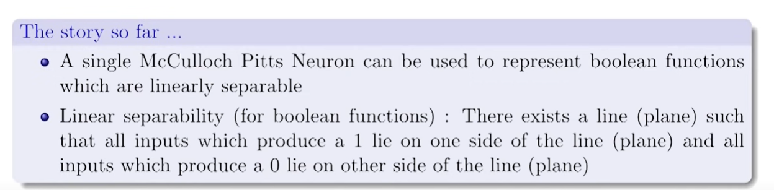

Slide 16
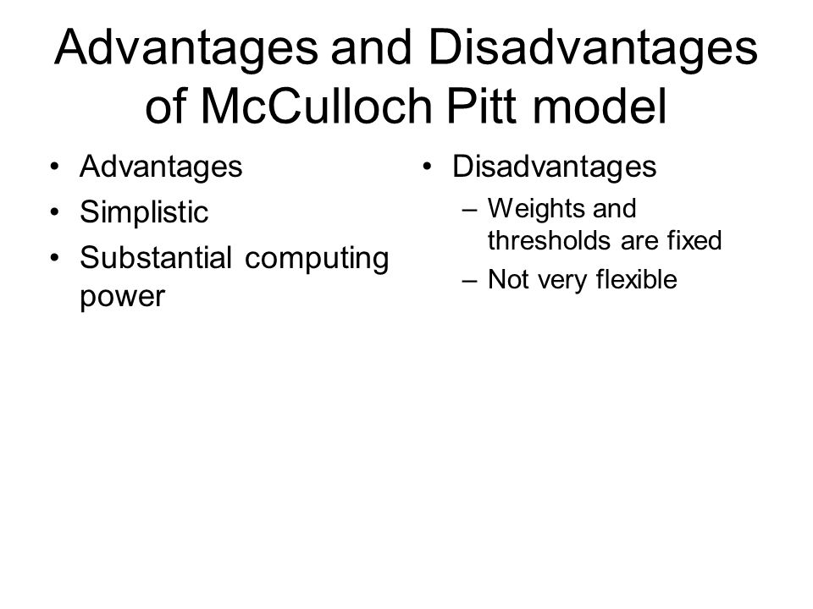


Slide 17
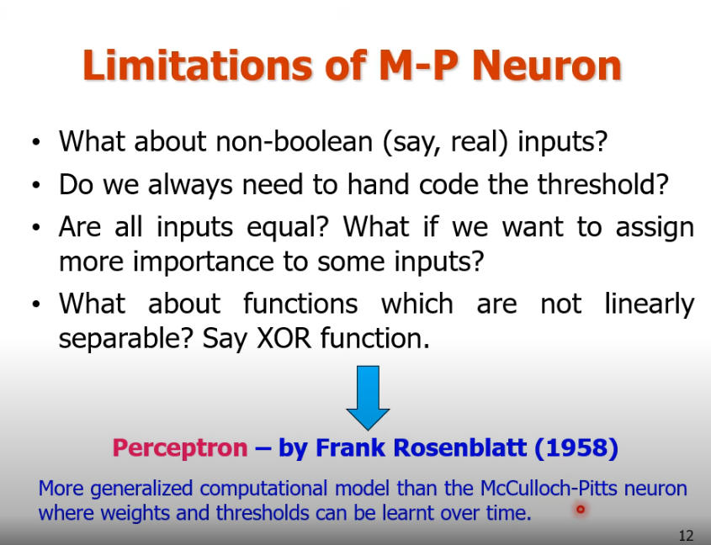

Slide 18
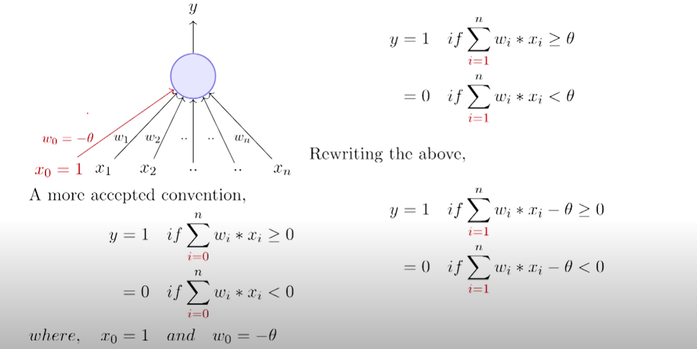
Perceptron
1
2
3

Slide 19
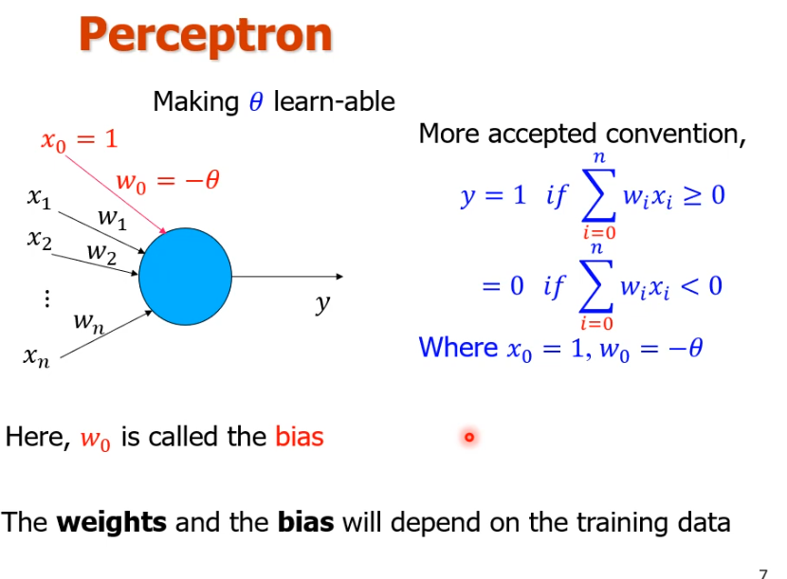

Slide 20
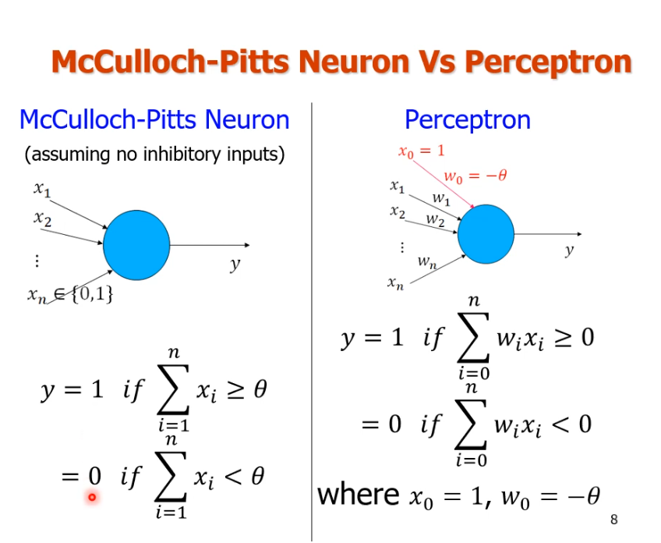

Slide 21
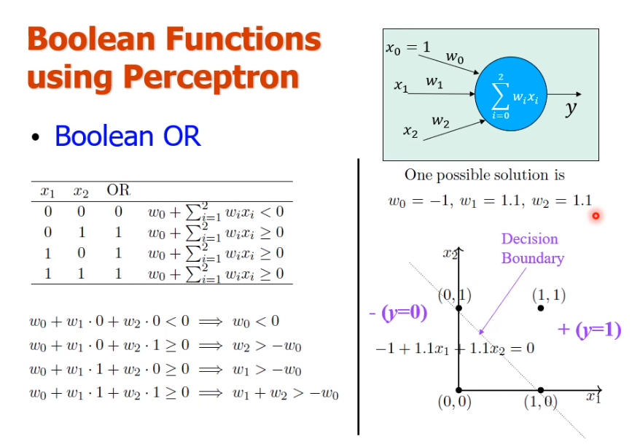

Slide 22
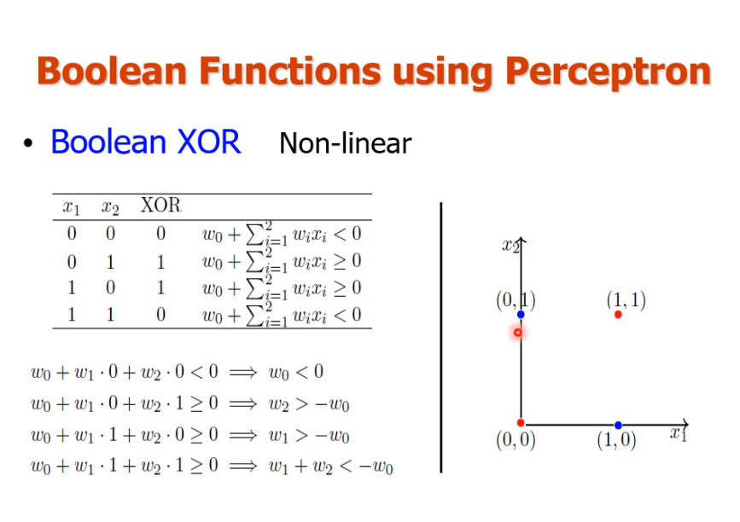

Slide 23
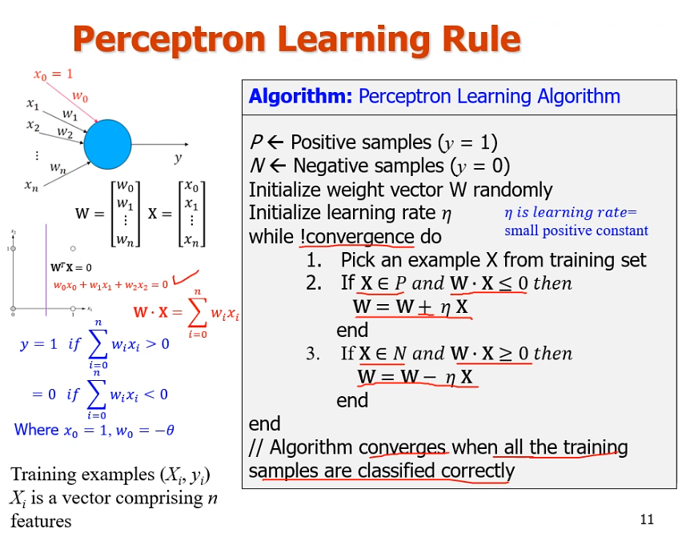

Slide 24
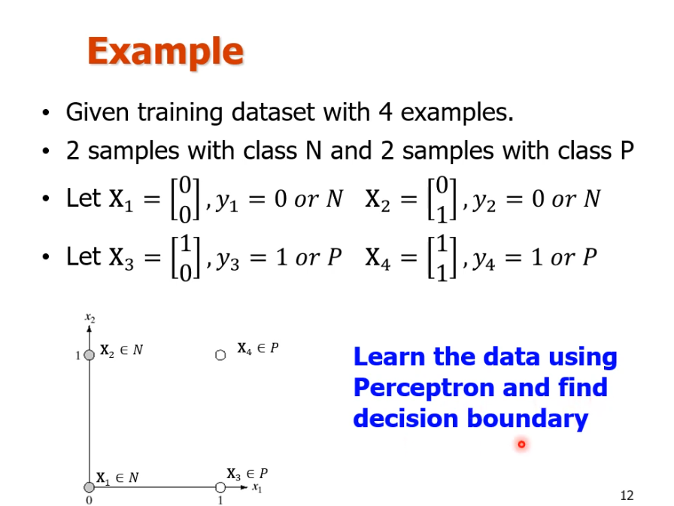

Slide 25
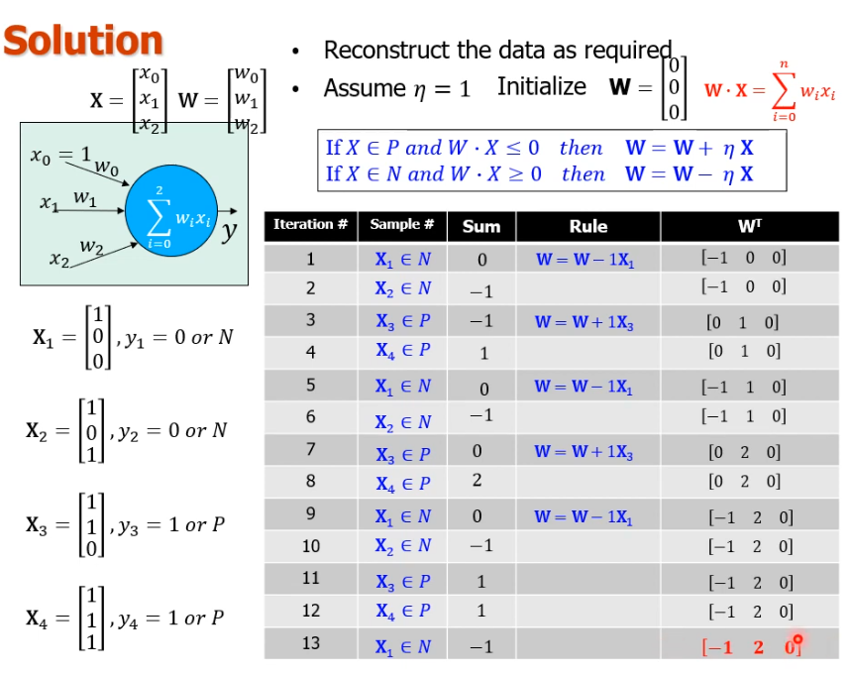

Slide 26
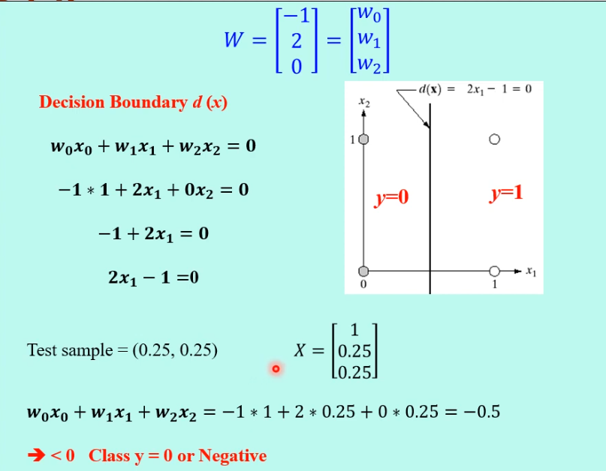

Slide 27
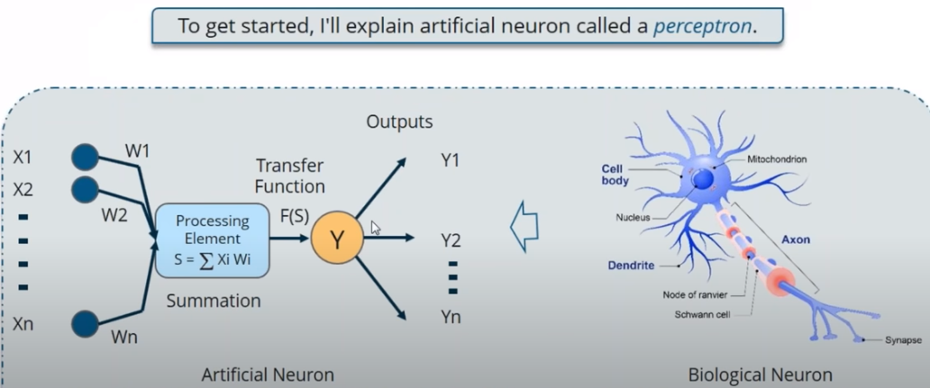
Perceptron

Slide 28
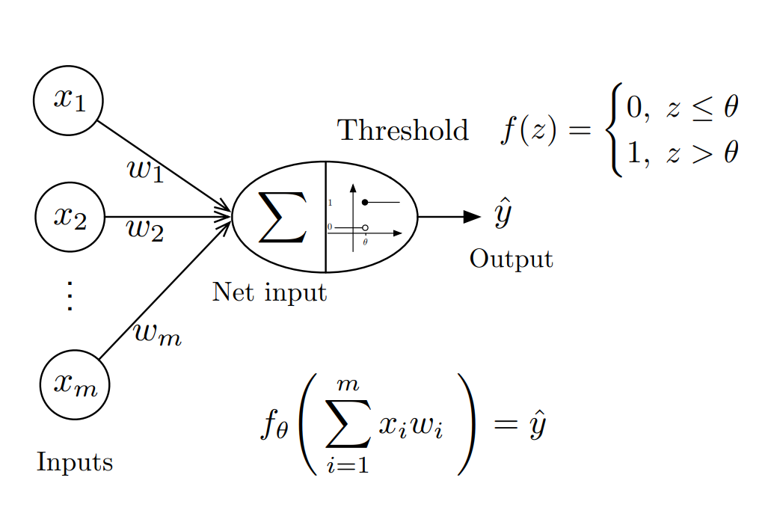
Perceptron

Slide 29
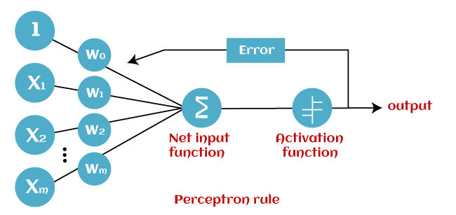
Perceptron
In Machine Learning, Perceptron is considered as a single-layer neural network that consists of four main parameters named input values (Input nodes), weights and Bias, net sum, and an activation function. The perceptron model begins with the multiplication of all input values and their weights, then adds these values together to create the weighted sum. Then this weighted sum is applied to the activation function 'f' to obtain the desired output. This activation function is also known as the step function and is represented by 'f'.

Slide 30
How Does A Neural Network Work?
To understand neural networks, we need to break it down and understand the most basic unit of a Neural Network, i.e. a Perceptron.
What Is A Perceptron?
A Perceptron is a single layer neural network that is used to classify linear data. It has 4 important components:
Inputs
Weights and Bias
Summation Function
Activation or transformation Function

Slide 31
The basic logic behind a Perceptron is as follows:
The inputs (x) received from the input layer are multiplied with their assigned weights w. The multiplied values are then added to form the Weighted Sum. The weighted sum of the inputs and their respective weights are then applied to a relevant Activation Function. The activation function maps the input to the respective output.
Weights and Bias In Deep Learning
Why do we have to assign weights to each input?
Once an input variable is fed to the network, a randomly chosen value is assigned as the weight of that input. The weight of each input data point indicates how important that input is in predicting the outcome.
The bias parameter, on the other hand, allows you to adjust the activation function curve in such a way that a precise output is achieved.
Summation Function or preactivation
Once the inputs are assigned some weight, the product of the respective input and weight is taken. Adding all these products gives us the Weighted Sum. This is done by the summation function.
Activation Function
The main aim of the activation functions is to map the weighted sum to the output. Activation functions such as tanh, ReLU, sigmoid and so on are examples of transformation functions.

Slide 32
Perceptron
1
2
3

Slide 33
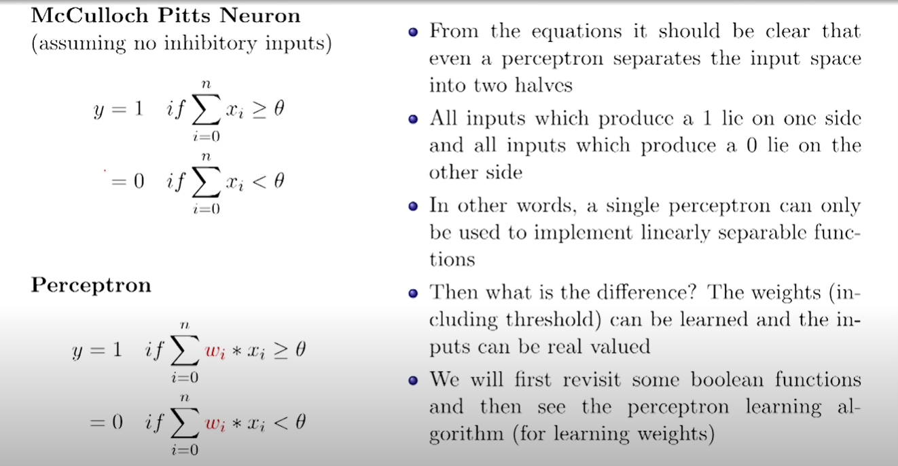

Slide 34
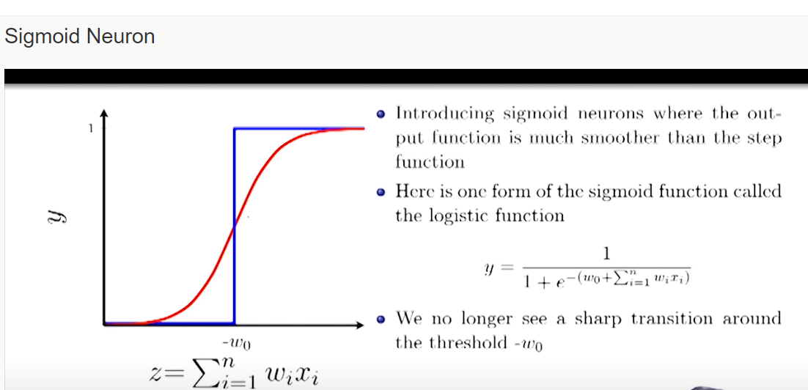

Slide 35
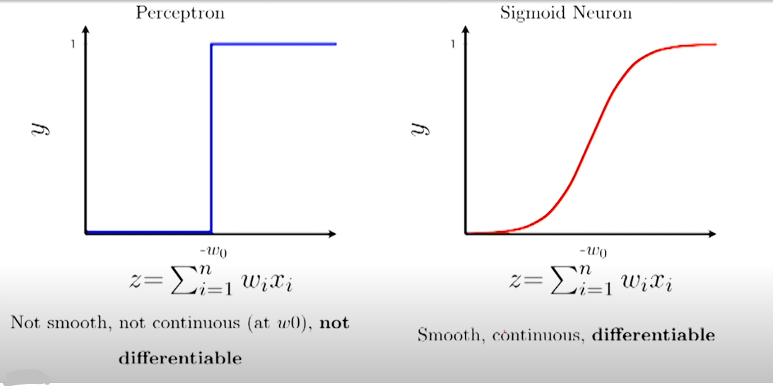

Slide 36
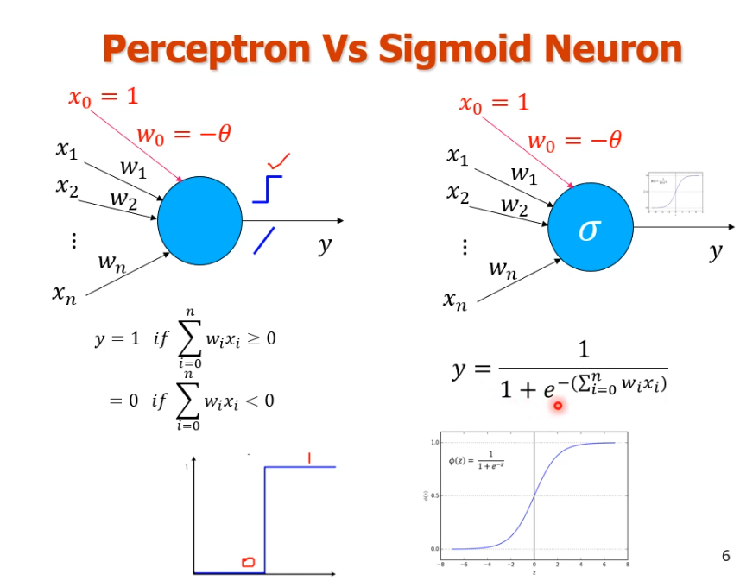

Slide 37
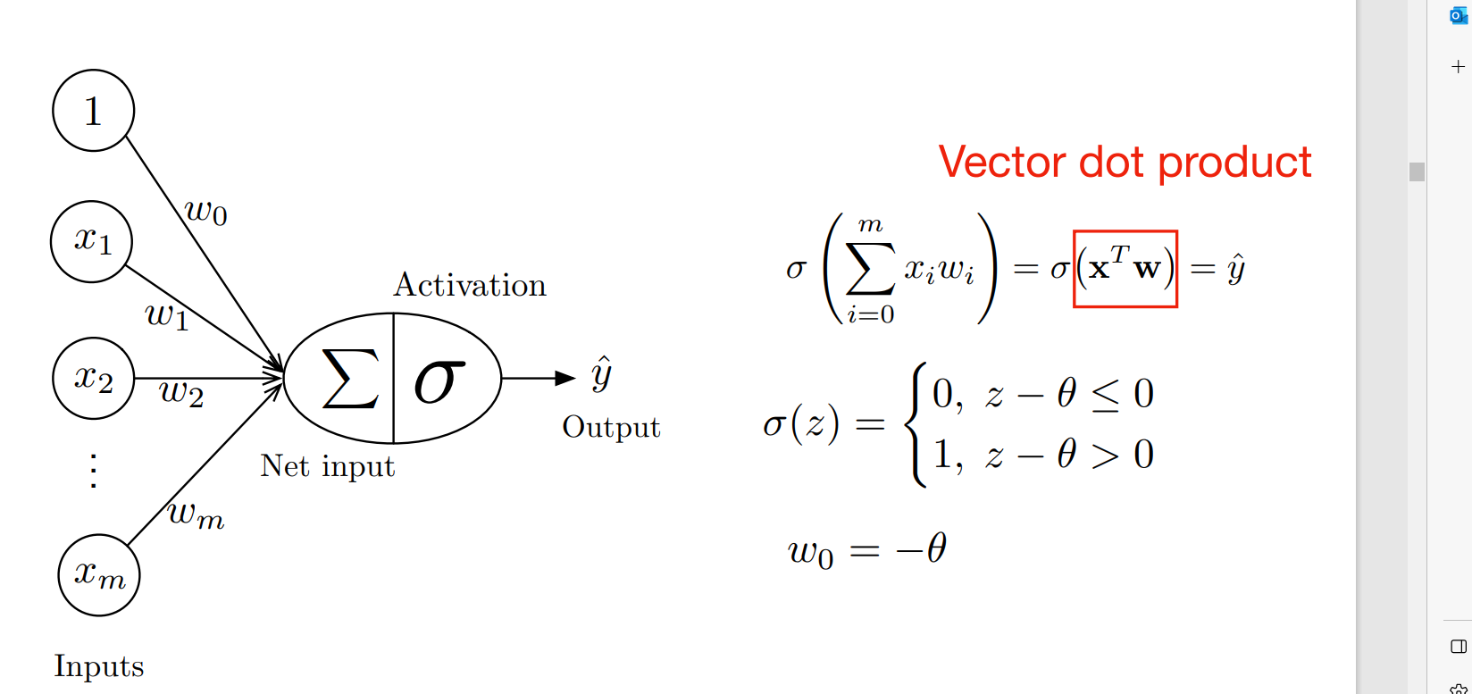
General Notation for Single-Layer Neural Networks
Sigmoid function

Slide 38
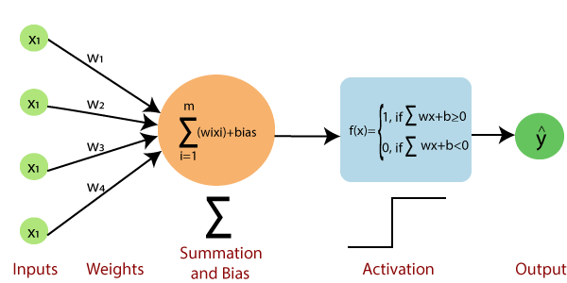
Limitations of Single-Layer Perceptron:
Single-Layer Percpetrons cannot classify non-linearly separable data points. (a non linear function is XOR, and other like OR, AND are linearly seperable.)
Complex problems, that involve a lot of parameters cannot be solved by Single-Layer Perceptrons.
It uses perceptron learning is used to update the weights
Notes:
XOR is not linearly separable function

Slide 39
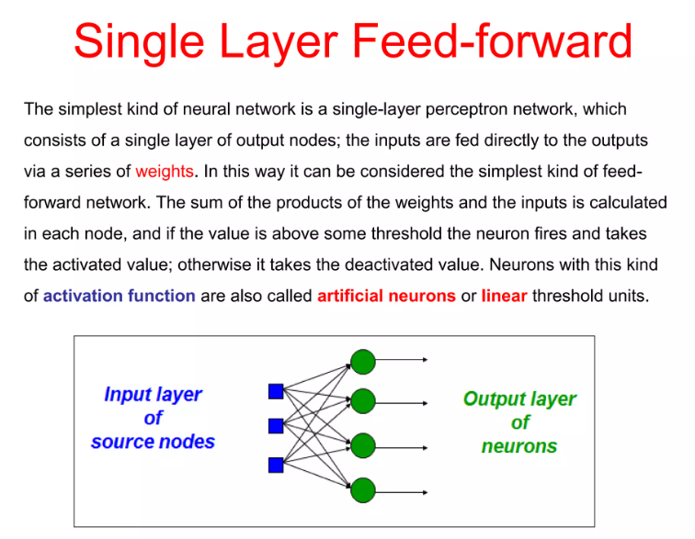

Slide 40
Implementation of logical gates using a single neuron

Slide 41
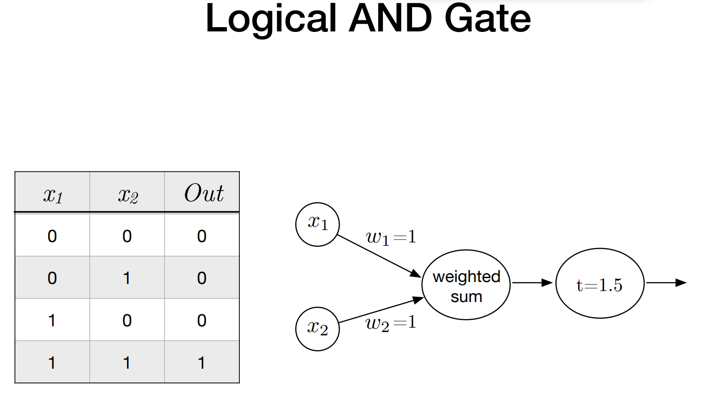
Single perceptron can be used to represent AND
2

Slide 42
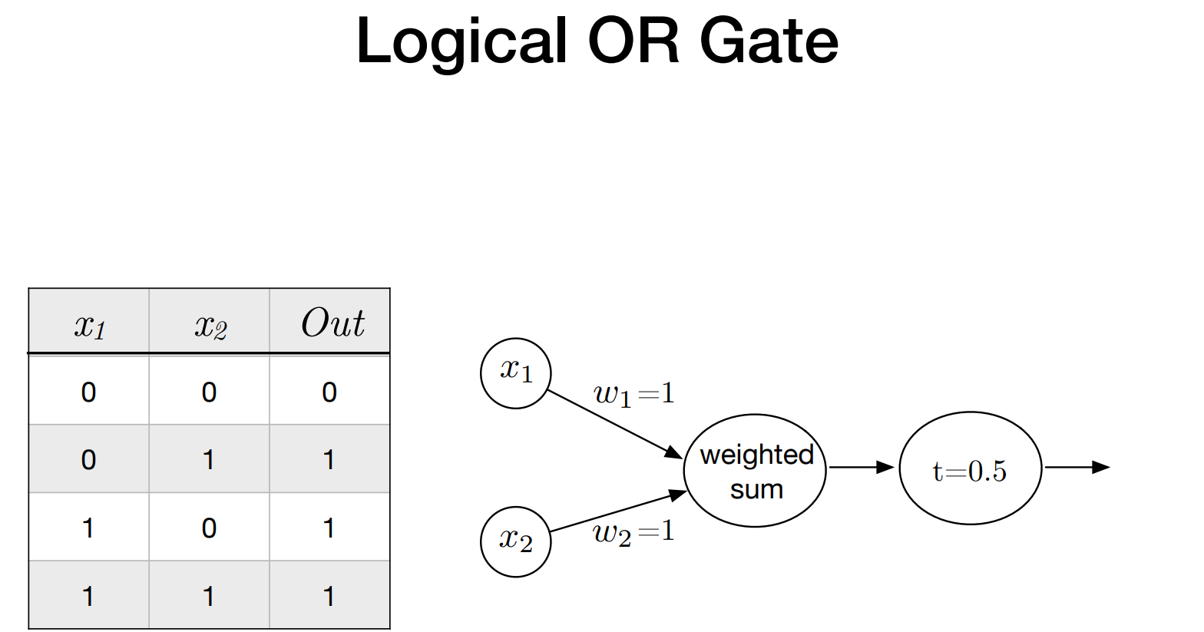
Single perceptron can be used to represent OR
1

Slide 43
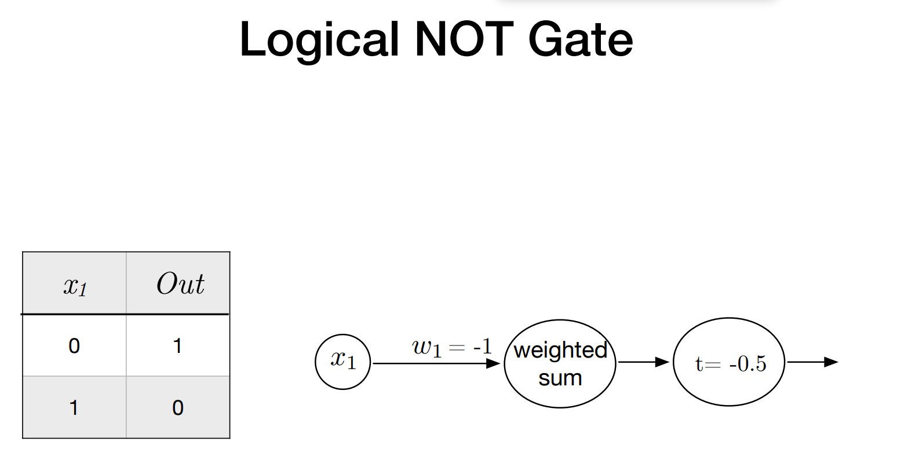
Single perceptron can be used to represent NOT
0

Slide 44
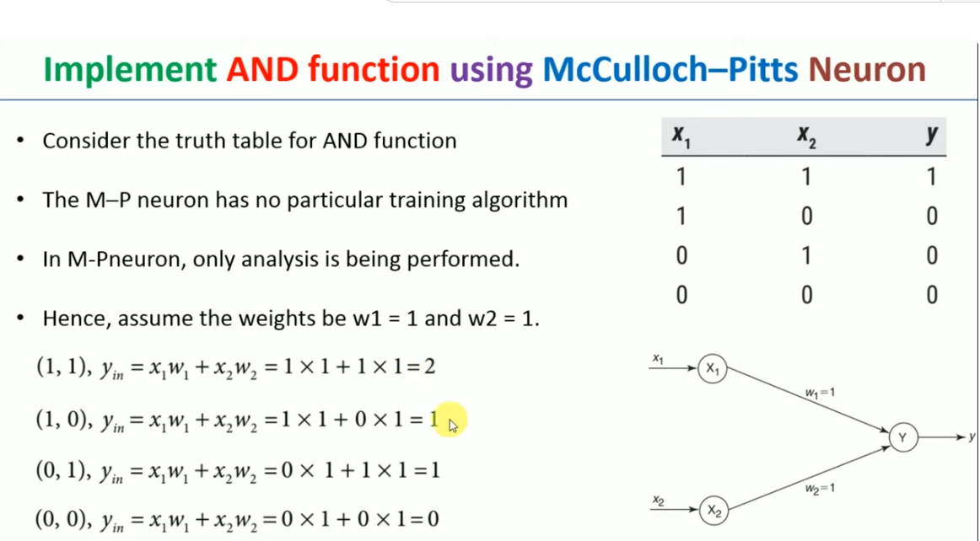

Slide 45
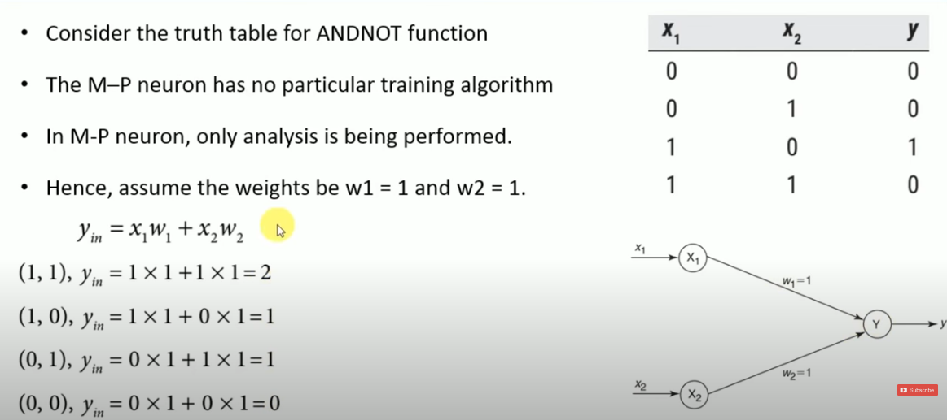

Slide 46
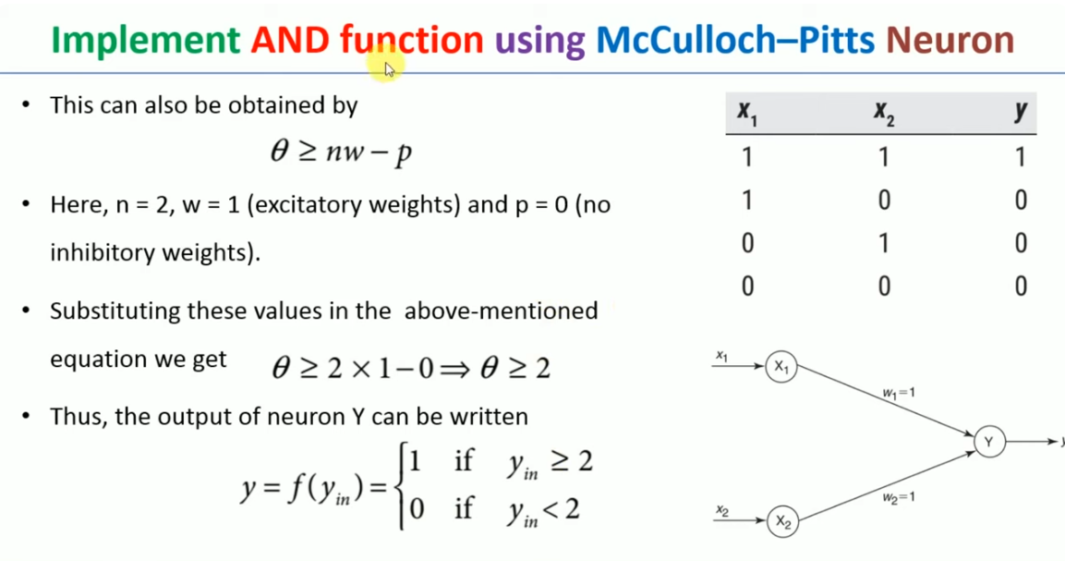

Slide 47
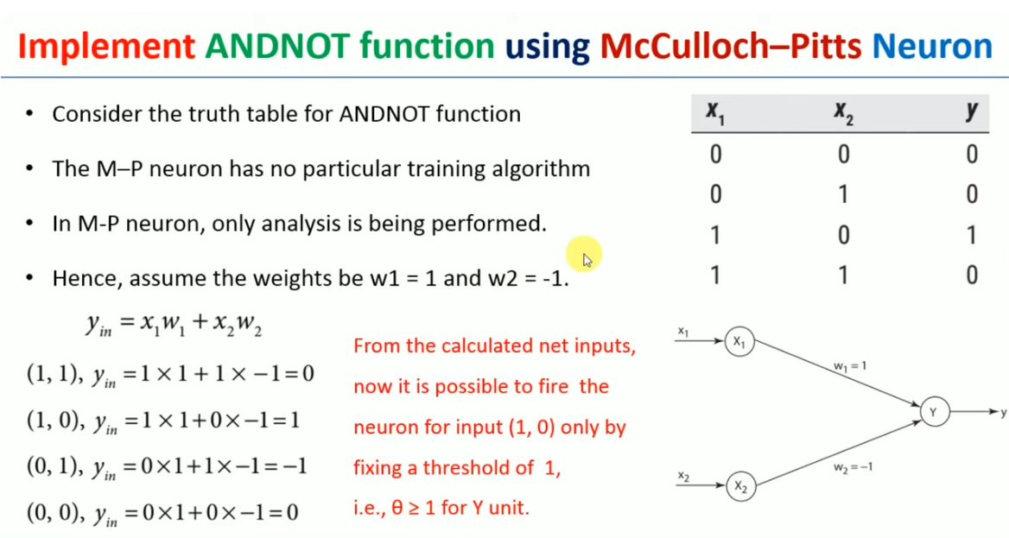

Slide 48
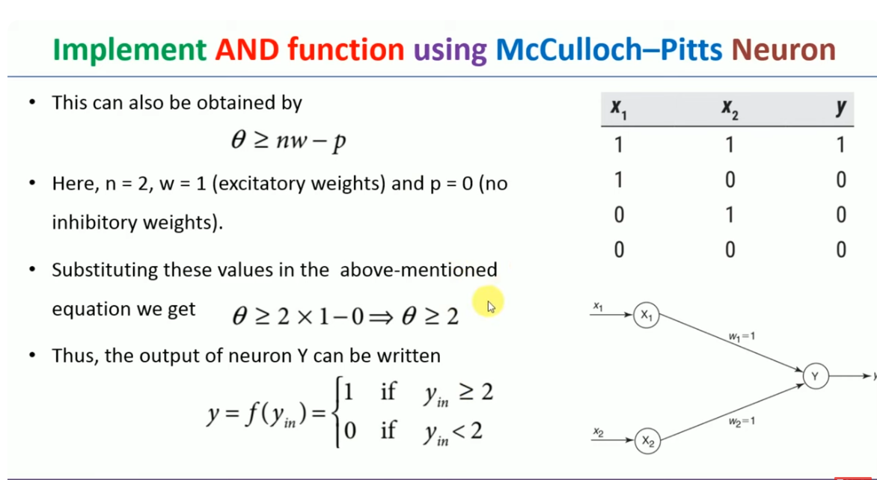

Slide 49
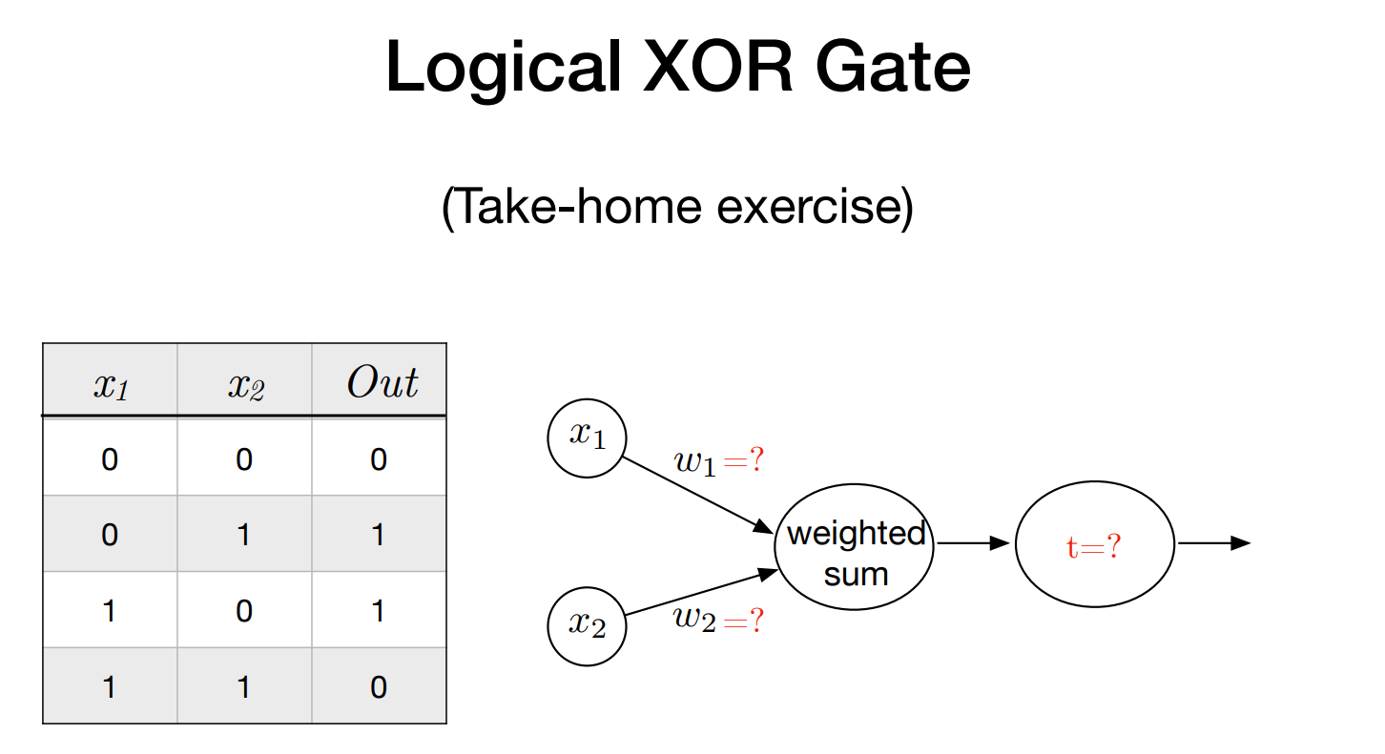
Single perceptron cant be used to perform XOR operation. For this a multilayer perceptron network is required

Slide 50
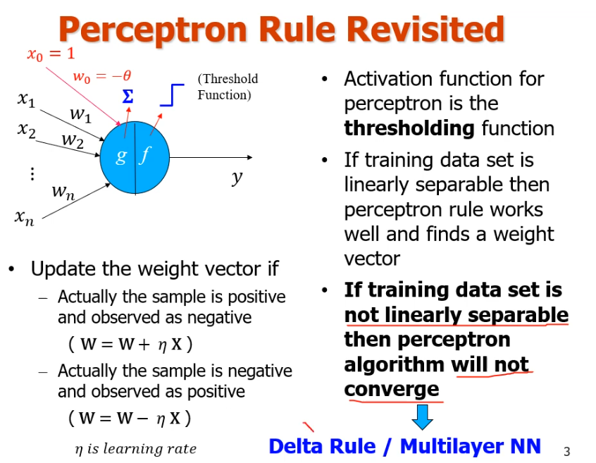

Slide 51
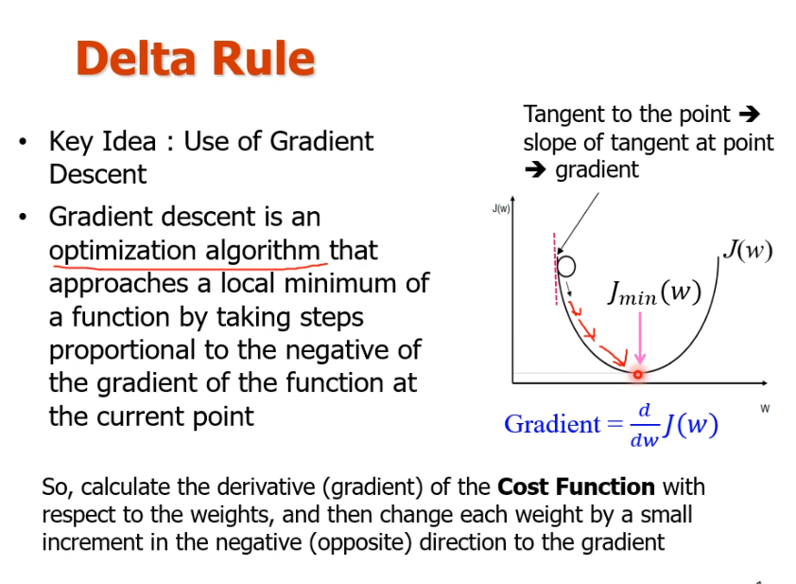
Notes:
GD is an optimization algorith,m that

Slide 52
Gradient Descent
Gradient Descent stands as a cornerstone orchestrating the intricate dance of model optimization. At its core, it is a numerical optimization algorithm that aims to find the optimal parameters—weights and biases—of a neural network by minimizing a defined cost function.
Gradient Descent (GD) is a widely used optimization algorithm in machine learning and deep learning that minimises the cost function of a neural network model during training. It works by iteratively adjusting the weights or parameters of the model in the direction of the negative gradient of the cost function until the minimum of the cost function is reached.
The learning happens during the backpropagation while training the neural network-based model. There is a term known as Gradient Descent, which is used to optimize the weight and biases based on the cost function. The cost function evaluates the difference between the actual and predicted outputs.

Slide 53
Gradient Descent
Gradient Descent is a fundamental optimization algorithm in machine learning used to minimize the cost or loss function during model training.
It iteratively adjusts model parameters by moving in the direction of the steepest decrease in the cost function.
The algorithm calculates gradients, representing the partial derivatives of the cost function concerning each parameter.
These gradients guide the updates, ensuring convergence towards the optimal parameter values that yield the lowest possible cost.
Gradient Descent is versatile and applicable to various machine learning models, including linear regression and neural networks. Its efficiency lies in navigating the parameter space efficiently, enabling models to learn patterns and make accurate predictions. Adjusting the learning rate is crucial to balance convergence speed and avoiding overshooting the optimal solution.

Slide 54
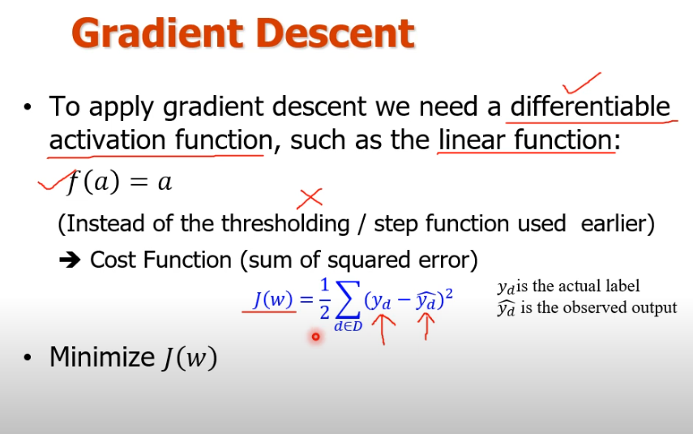

Slide 55
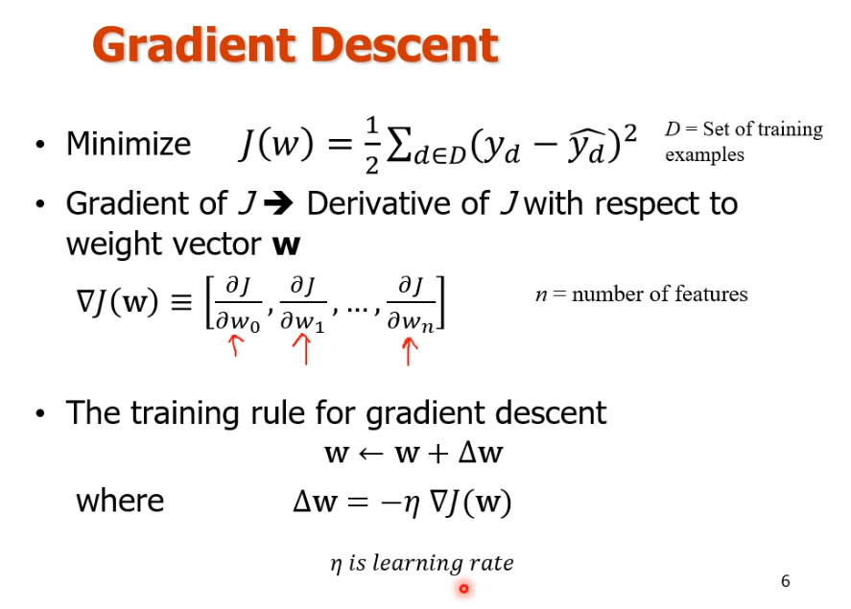

Slide 56
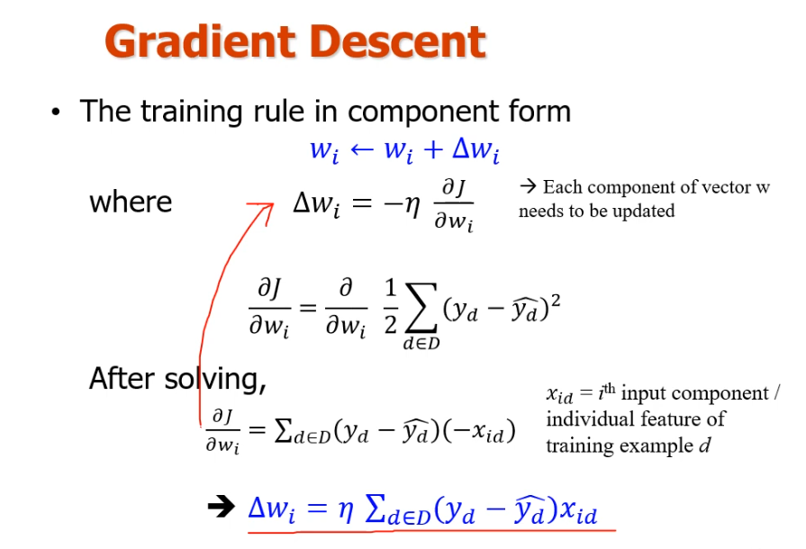

Slide 57
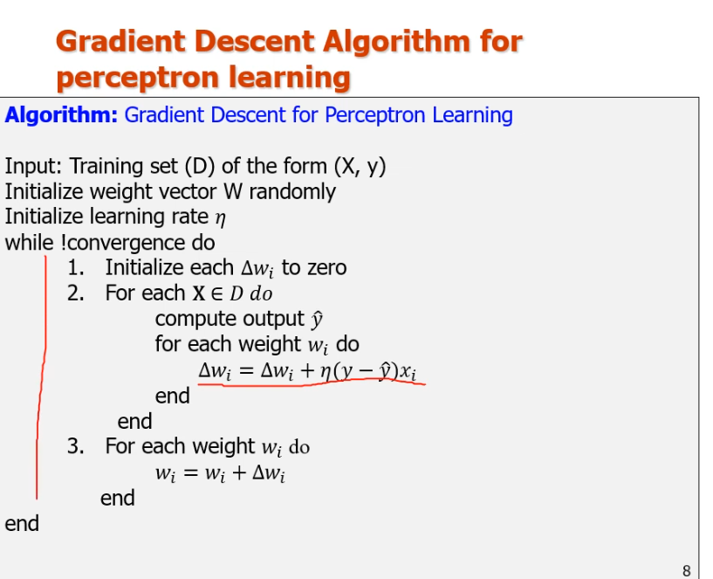

Slide 58
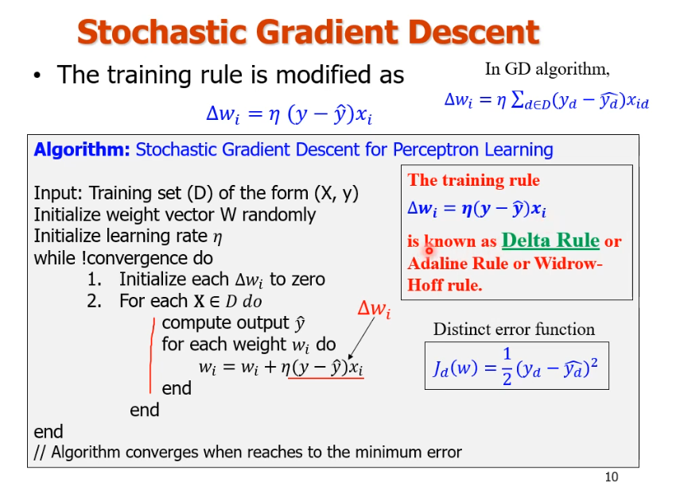

Slide 59
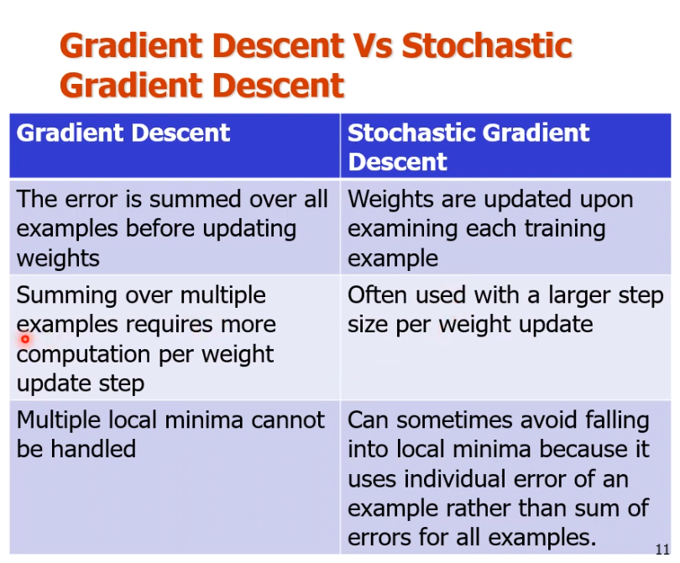

Slide 60


Slide 61


Logical XOR gate

Slide 62


Slide 63

What is Multi-Layer Perceptron (Artificial Neural Network)?
As you know our brain is made up of millions of neurons, so a Neural Network is really just a composition of Perceptrons, connected in different ways and operating on different activation functions. A multi layer perception can deal with non linear Boolean functions such as XOR.

Slide 64


Slide 65
Input Nodes – The Input nodes provide information from the outside world to the network and are together referred to as the “Input Layer”. No computation is performed in any of the Input nodes – they just pass on the information to the hidden nodes.
Hidden Nodes – The Hidden nodes have no direct connection with the outside world (hence the name “hidden”). They perform computations and transfer information from the input nodes to the output nodes. A collection of hidden nodes forms a “Hidden Layer”. While a network will only have a single input layer and a single output layer, it can have zero or multiple Hidden Layers. A Multi-Layer Perceptron has one or more hidden layers.
Output Nodes – The Output nodes are collectively referred to as the “Output Layer” and are responsible for computations and transferring information from the network to the outside world.

Slide 66

3-layer Multilayer Network

Slide 67


2-layer Multilayer Network

Slide 68

Feedforward Neural Networks (a.k.a. multilayered network of neurons)
activation
Pre-activation

Slide 69


Slide 70


Slide 71

Activation Functions
Activation functions are an extremely important feature of the artificial neural networks. They basically decide whether a neuron should be activated or not. Whether the information that the neuron is receiving is relevant for the given information or should it be ignored.

Slide 72

Different activation functions are:

Slide 73

Simple type of function
Very Straight forward
Rigid type of function only yes or no

Slide 74

A sigmoid function is a bounded, differentiable, real function that is defined for all real input values and has a non-negative derivative at each point.
Used in Logistic regression
Very smooth (Predict the Probability)

Slide 75

sigmoid

Slide 76

Rectified Linear Unit (Relu)
One of the most popular function in Artificial Neural Network
Gradually progress

Slide 77
Relu function
The rectified linear unit (ReLU) or rectifier activation function introduces the property of nonlinearity to a deep learning model and solves the vanishing gradients issue. It interprets the positive part of its argument.

Slide 78

Similar to the sigmoid function only the difference is goes below to Zero.

Slide 79

Tanh function
The tanh activation function, also called the hyperbolic tangent activation function, is a mathematical function commonly used in artificial neural networks for their hidden layers. It transforms input values to produce output values between -1 and 1. It is expressed as the ratio of the difference between the exponential of the input value and the exponential of its negation to the sum of these exponentials.

Slide 80
Backpropagation in neural network
Backpropagation is the essence of neural network training. ... Backpropagation in neural network is a short form for "backward propagation of errors." It is a standard method of training artificial neural networks. This method helps calculate the gradient of a loss function with respect to all the weights in the network

Slide 81
Why We Need Backpropagation?
While designing a Neural Network, in the beginning, we initialize weights with some random values or any variable for that fact.
Now obviously, we are not superhuman. So, it’s not necessary that whatever weight values we have selected will be correct, or it fits our model the best.
Okay, fine, we have selected some weight values in the beginning, but our model output is way different than our actual output i.e. the error value is huge.
Now, how will you reduce the error?
Basically, what we need to do, we need to somehow explain the model to change the parameters (weights), such that error becomes minimum.
Let’s put it in an another way, we need to train our model.

Slide 82

Backpropagation

Slide 83
Let me summarize the steps:
Calculate the error
Minimum Error
Update the parameters
Model is ready to make a prediction

Slide 84
What is Backpropagation?
The Backpropagation algorithm looks for the minimum value of the error function in weight space using a technique called the delta rule or gradient descent. The weights that minimize the error function is then considered to be a solution to the learning problem.
Let’s understand how it works with an example:

Slide 85
Now, what we did here:
We first initialized some random value to ‘W’ and propagated forward.
Then, we noticed that there is some error. To reduce that error, we propagated backwards and increased the value of ‘W’.
After that, also we noticed that the error has increased. We came to know that, we can’t increase the ‘W’ value.
So, we again propagated backwards and we decreased ‘W’ value.
Now, we noticed that the error has reduced.

Slide 86

Where first W is the updated weight
Second W previous weight
Yi is the original label
Yi hat is the predicted label
Eta is the learning rate

Slide 87

Consider the graph below:Gradient Descent

Slide 88
The gradient at different points is found out.
If the gradient value is positive at a point, it will be required to move to left or reduce the weight.
If the gradient value is negative at a point, it will be required to increment the value of weight.
The above two steps are done until the minima is reached.
The minima could either be local minima or the global minima. There are different techniques which can be used to find local vs global minima.

Slide 89



Slide 90


Slide 91


Slide 92
So, we are trying to get the value of weight such that the error becomes minimum. Basically, we need to figure out whether we need to increase or decrease the weight value. Once we know that, we keep on updating the weight value in that direction until error becomes minimum. You might reach a point, where if you further update the weight, the error will increase. At that time you need to stop, and that is your final weight value.
We need to reach the ‘Global Loss Minimum’.
This is nothing but Backpropagation.
Let’s now understand the math behind Backpropagation.

Slide 93


Slide 94


Slide 95


Slide 96


Slide 97


Slide 98


Slide 99


Slide 100


Slide 101


